Slide 1
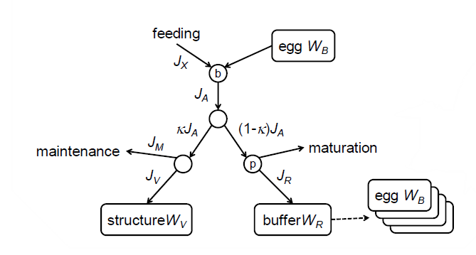
Embryo mortality rate (μ_{emb})
Post-hatch mortality rate (μ_{lar})
y_{VA}
y_{BA}

Slide 2
Egg (W_{B})
Feeding

